Slide 1
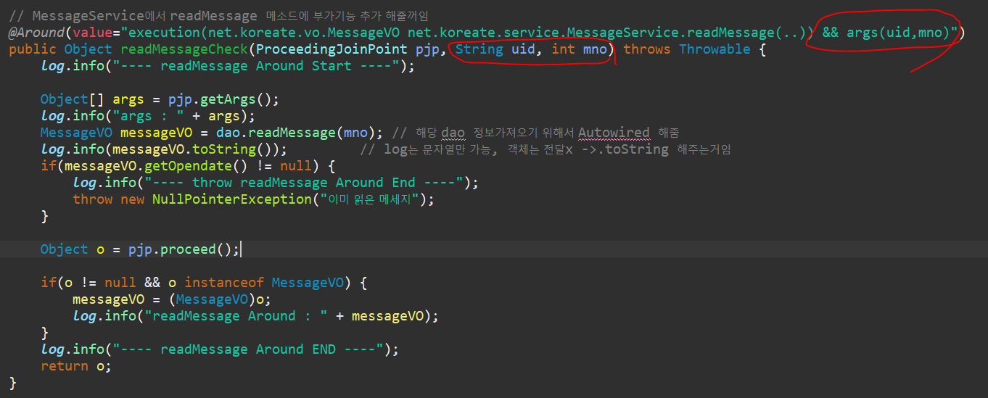

Slide 2
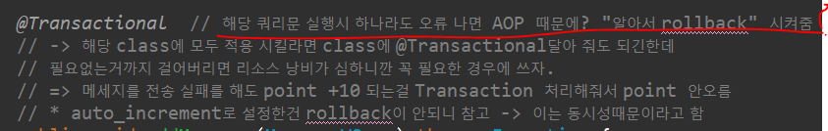

Slide 3
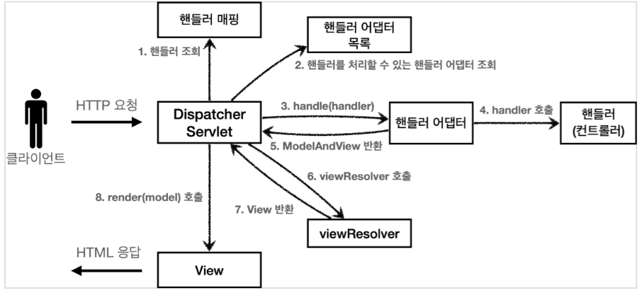
Controller 찾음
해당 Controller의
각각의 method들
https://catsbi.oopy.io/f52511f3-1455-4a01-b8b7-f10875895d5b

Slide 4
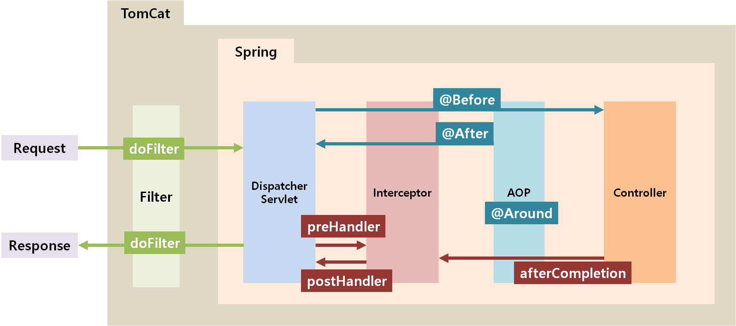

WAS
Spring Container

Slide 5
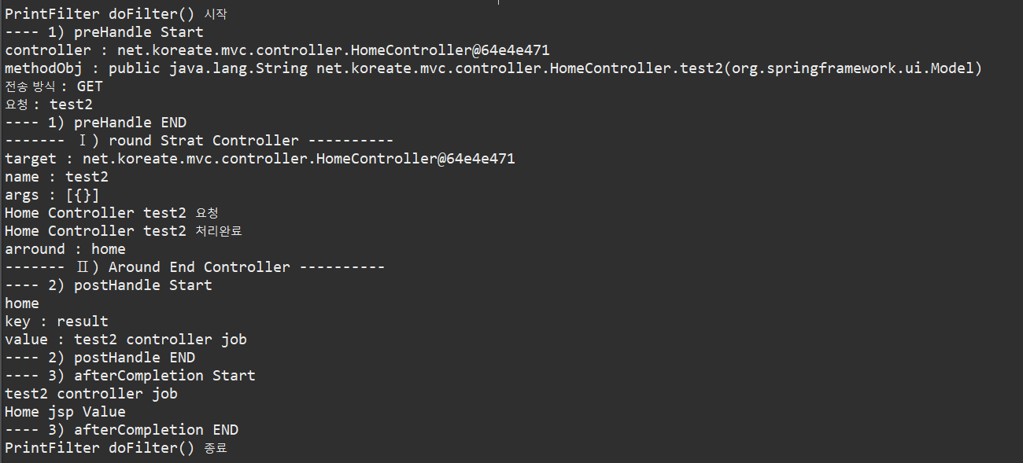

Slide 6
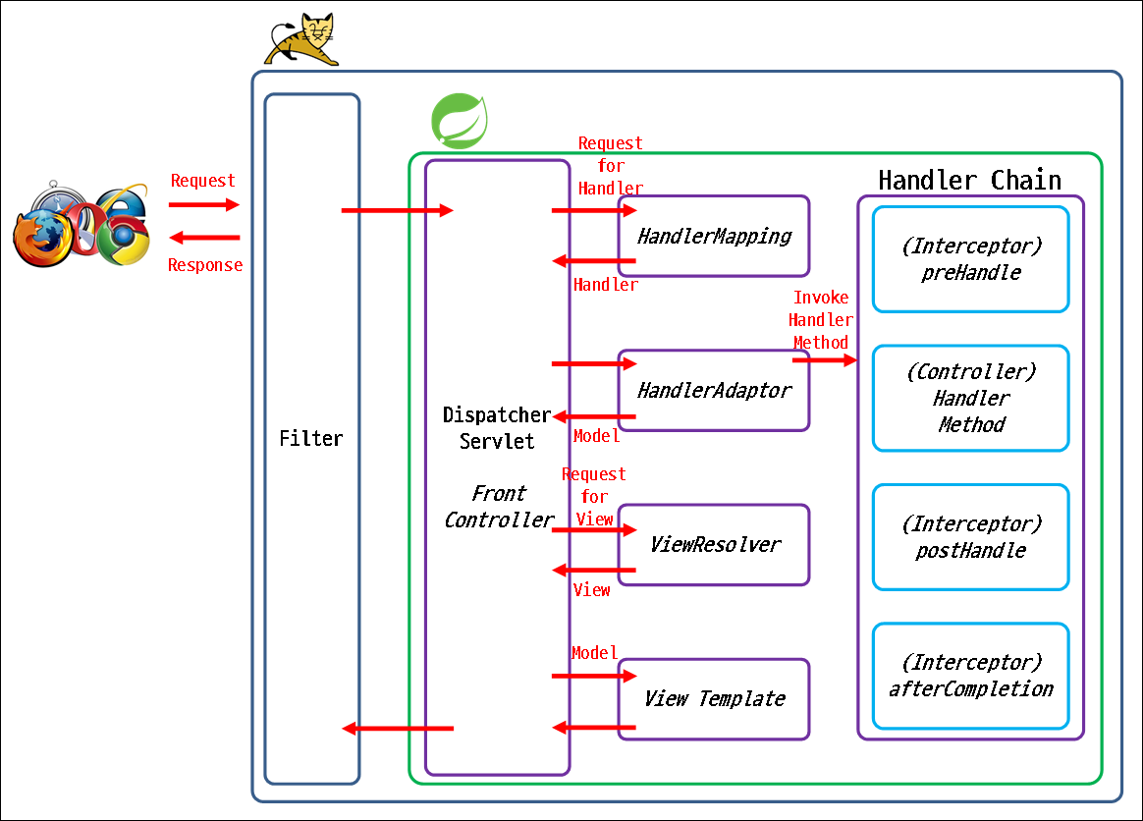
https://xxxelppa.tistory.com/329

